Slide 1
Fracture Healing
Tissue Healing

Slide 2
Bellwork
Take a minute and think about the following questions. Be prepared to share your responses with the class:
What are the three phases of soft tissue healing?
Do you think bones heal in the same way? Why or why not?

Slide 3
Objectives
Identify terminology specific to bones
Understand and describe purpose of bones in the body
Describe the phases of fracture healing
Compare/contrast soft tissue healing with bone healing

Slide 4
Terminology
Osteoblasts- cells that add collagen and minerals to bone
Osteoclasts- cells that remove minerals and collagen from bone
Stem cells- cells produced in bone marrow that can become new blood, heart, bone or brain cells
Wolff’s Law- tissues will adapt to stresses being placed upon them by changing size, shape or structure

Slide 5
Skeletal Bones
What are the purpose of bones in the body?
5
Notes:
5. Pass or Play
teacher poses a question and gives wait time
teacher calls on a student and asks them “pass or play?”
student says “play” if they wish to answer the question or “pass to__________” if they want to pass to a specific classmate
teacher provides feedback

Slide 6
Functions of Bones
Protection
Support
Movement
Mineral storage
Bone marrow production
Stem cell production
Red blood cell production and storage

Slide 7
Osteoclasts form new bone cells while osteoblasts break down the old bone.
?
Thumbs up / Thumbs down
7
Notes:
1. Hand signals:
thumbs up or thumbs down to indicate agreement or disagreement
use fingers to indicate a number selection such as “Which is the correct solution one, two or three?”
teacher gives feedback to the students

Slide 8
Bones are continuously renovating
Osteoclasts are tearing down old or damaged bone tissue, like fragments or ragged ends.
Osteoblasts are generating healthier bone tissue constantly.
Every seven years, nearly every cell of your body is broken down & replaced, including your bones!

Slide 9
Inflammatory Response
With fracture, capillaries are broken.
A clot forms called a fracture hematoma.
Leukocytes and osteoclasts move in to clean out damage.
Inflammation
Infection prevention
Healing starts about a week later when fibroblasts start laying down new cartilage.

Slide 10
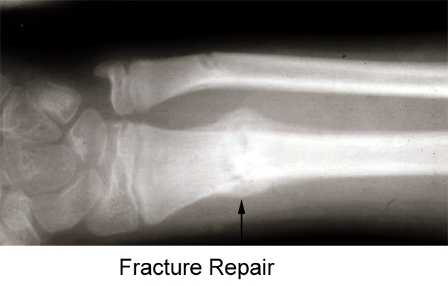
Fibroblastic Phase
Collagen being produced within a week beginning callus formation.
Osteoblasts transform the cartilage-like callus into bone.
Osteoclasts remove any excess callus.
This can take 3-8 weeks depending on severity of fracture.
http://pathol.med.stu.edu.cn/pathol/listEngContent2.aspx?ContentID=500

Slide 11
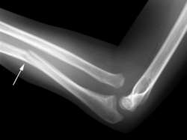
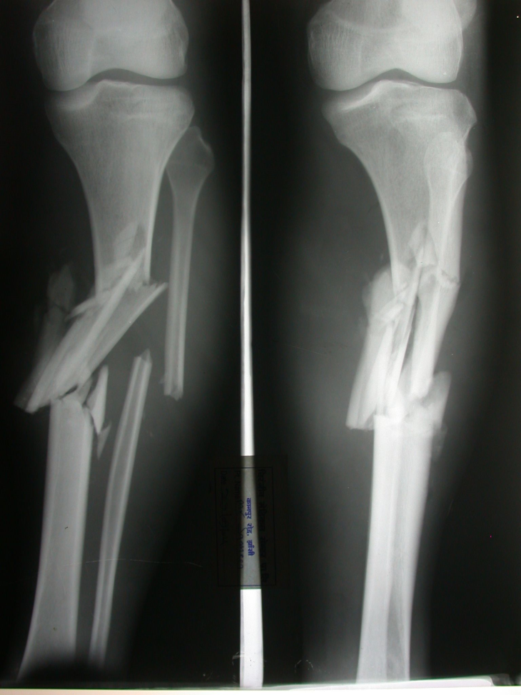
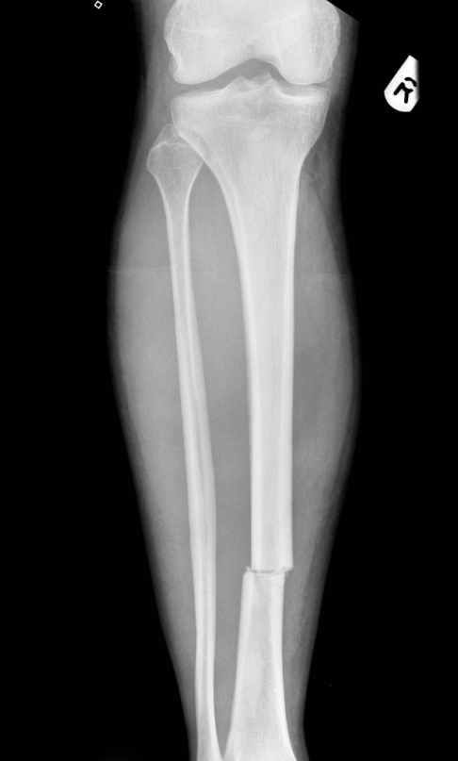
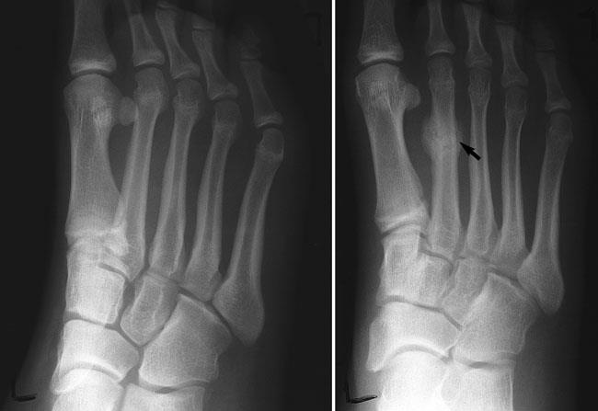
Take a guess!
Which fracture do you think will heal the fastest? Slowest?

Slide 12
Maturation Phase
Osteoblasts and osteoclasts continuously remodel the fracture site
Fracture maturation may continue for a year or more depending on the severity of the damage.
Inflammation should be significantly decreased by this phase in healing.

Slide 13
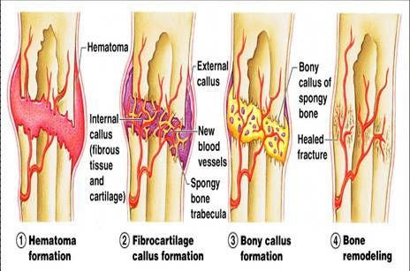

Slide 14
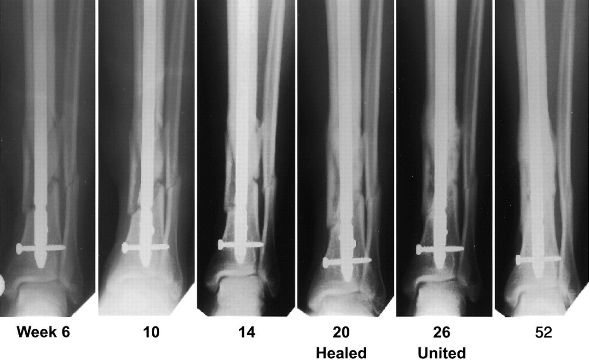

Slide 15
Changes in Bone Healing
Bone will not heal as quickly or strongly if:
There is poor blood supply due to swelling or severed arteries.
The bone was improperly or never reset.
There was an open wound that got infected at or near the fracture site.
The patient is poorly nourished.

Slide 16
Healing Differences
Bone
Soft Tissue
Heals as good as new
Vascularized
Can strengthen
Collagen scar- will never grow same tissue
Inelastic
Avascular

Slide 17
Outcome Statements
I would like to know
more about . . .
I now
understand . . .
I need more
help
with . . .
17
Notes:
23. Outcome Statements
teacher gives the following prompts
I now understand . . .
I would like to know more about . . .
I need more help with . . .
I could teach someone else to . . .
teacher collects their written responses or does a think-pair-share

